Slide 1
Digital Image Processing
Lecture 5: Image Enhancement in Spatial Domain

Slide 2
Mathematical/Logical Operations on Images

Slide 3
Mathematical/Logical Operations on Images
Addition
  –Averaging images for noise removal
Subtraction
  –Removal of background from images
  –Image enhancement
  –Image matching
  –Moving/displaced object tracking
Multiplication
  –Superimposing of texture on an image
  –Convolution and correlation of images
And and or operations
  –To remove the unnecessary area of an image through
  mask operations

Slide 4
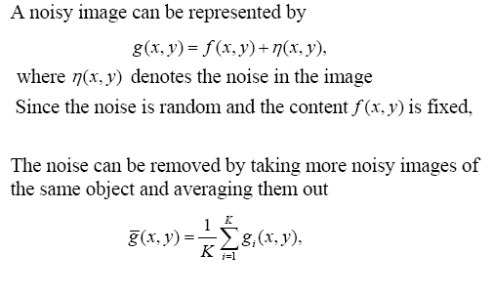
Image Averaging for Noise Reduction

Slide 5
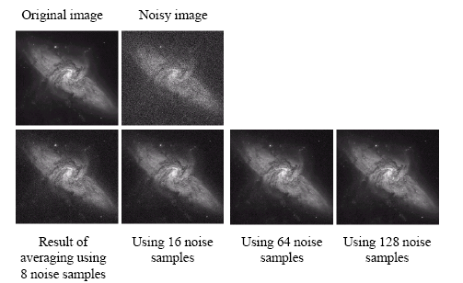
Image Averaging for Noise Reduction

Slide 6
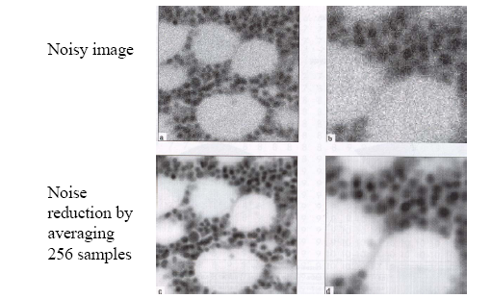
Image Averaging for Noise Reduction

Slide 7
Image Subtraction
Takes two images as input and produces a third image whose pixel values are those of the first image minus the corresponding pixel values from the second image
Variants
  It is also often possible to just use a single image as input and subtract a constant value from all the pixels
  Just output the absolute difference between pixel values, rather than the straightforward signed output.

Slide 8



Image Subtraction
The subtraction of two images is performed in a single pass
If the operator computes absolute differences between the two input images then:
If it is simply desired to subtract a constant value C from a single image then:

Slide 9
Image Subtraction
If the operator calculates absolute differences, then it is impossible for the output pixel values to be outside the range
In rest of the two cases the pixel value may become negative
This is one good reason for using absolute differences.
How to solve problem of negative pixels?

Slide 10
Image Subtraction
How to solve problem of negative pixels?
Let we have an 8 bit Grayscale image (Value Range= 0 t0 255)
The result of image subtraction may come in the range of -255 to +255
One scheme can be to add 255 to every pixel and then divide by 2
Method is easy and fast
Limitations
  Truncation errors can cause loss of accuracy
  Full range of display may not be utilized

Slide 11
Image Subtraction
How to solve problem of Negative Pixels?
Another scheme can be
  Find value of Minimum Difference
  Add this value to all pixels in the Difference Image. This will make a modified difference image whose minimum value is 0
  All pixel values are then scaled to the interval [0,255] by multiplying each pixel by the quantity 255/Max where Max is the maximum value in the modified image.

Slide 12
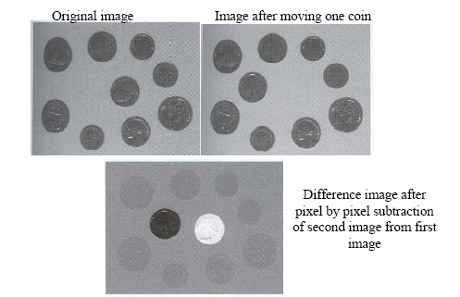
Examples of Image Subtraction

Slide 13
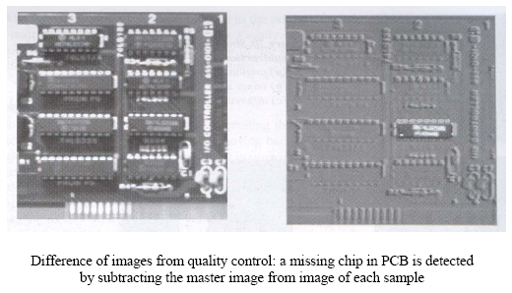
Examples of Image Subtraction

Slide 14
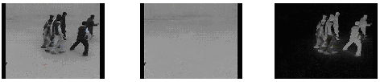
Example: Background Removal Using Image Subtraction

Slide 15



Example: Background Removal Using Image Subtraction

Slide 16
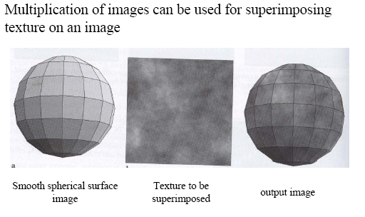
Examples of Image Multiplication

Slide 17
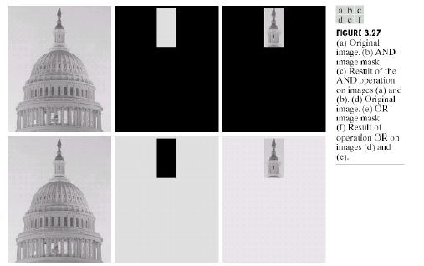
Example of Logical Operations using Masks

Slide 18
Mathematical/Logical Operations on Images

Slide 19
Local Enhancement through Spatial Filtering
The output intensity value at (x,y) depends not only on the input intensity value at (x,y) but also on the specified number of neighboring intensity values around (x,y)
Spatial masks (also called window, filter, kernel,
template) are used and convolved over the entire image for local enhancement (spatial filtering)
The size of the mask determines the number of
neighboring pixels which influence the output
value at (x,y)
The values (coefficients) of the mask determine the
nature and properties of enhancing technique

Slide 20
Neighbourhood Operations
Neighbourhood operations simply operate on a larger neighbourhood of pixels than point operations
Neighbourhoods are
mostly a rectangle
around a central pixel
Any size rectangle
and any shape filter
are possible
Origin
x
(x, y)
Neighbourhood
y
Image f (x, y)

Slide 21
Simple Neighbourhood Operations
Some simple neighbourhood operations include:
  Min: Set the pixel value to the minimum in the neighbourhood
  Max: Set the pixel value to the maximum in the neighbourhood
  Median: The median value of a set of numbers is the midpoint value in that set (e.g. from the set [1, 7, 15, 18, 24] 15 is the median). Sometimes the median works better than the average

Slide 22
Simple Neighbourhood Operations Example
Original Image
x
Enhanced Image
x
123
127
128
119
115
130
140
145
148
153
167
172
133
154
183
192
194
191
194
199
207
210
198
195
164
170
175
162
173
151
y
y

Slide 23
The Spatial Filtering Process
Origin
x
a
b
c
r
s
t
d
e
f
*
u
v
w
g
h
i
x
y
z
Original Image Pixels
Filter
Simple 3*3
Neighbourhood
e
3*3 Filter
e_{processed} = v*e +
r*a + s*b + t*c +
u*d + w*f +
x*g + y*h + z*i
y
Image f (x, y)
The above is repeated for every pixel in the original image to generate the smoothed image

Slide 24
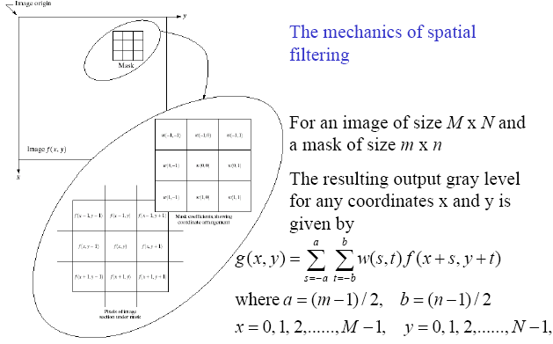
Local Enhancement through Spatial Filtering

Slide 25
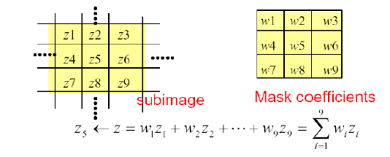
Basics of Spatial Filtering
Given the 3×3 mask with coefficients: w₁, w₂,…, w₉
The mask covers the pixels with gray levels: z₁, z₂,…, z₉
z gives the output intensity value for the processed image
(to be stored in a new array) at the location of z₅ in the
input image

Slide 26
Basics of Spatial Filtering
Mask operation near the image border
Problem arises when part of the mask is located outside the
image plane; to handle the problem:
1. Discard the problem pixels (e.g. 512x512input 510x510output, if mask size is 3x3)
2. Zero padding: expand the input image by padding zeros
(512x512input 514x514output)
  – Zero padding is not good; creates artificial lines or edges on the
  border
3. We normally use the gray levels of border pixels to fill up the expanded region (for 3x3 mask). For larger masks a border region equal to half of the mask size is mirrored on the expanded region.

Slide 27
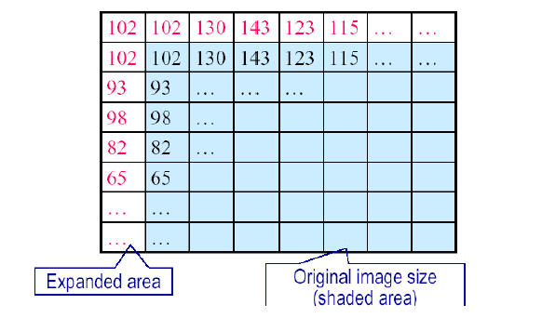
Mask Operation Near the Image Border

Slide 28
Spatial Filtering for Smoothing
For blurring/noise reduction;
Blurring is usually used in preprocessing steps,
e.g., to remove small details from an image prior to object extraction, or to bridge small gaps in lines or curves
Equivalent to Low-pass spatial filtering in frequency domain because smaller (high frequency) details are removed based on
neighborhood averaging (averaging filters)
Implementation: The simplest form of the spatial
filter for averaging is a square
mask (assume m×m mask) with
the same coefficients 1/m2 to
preserve the gray levels
(averaging).
Applications: Reduce noise; smooth false contours
Side effect: Edge blurring

Slide 29
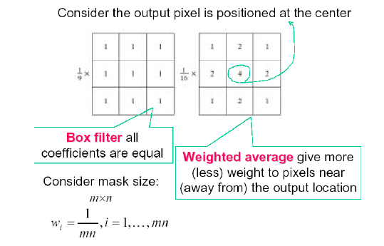
Smoothing Filters

Slide 30
Smoothing Spatial Filters
One of the simplest spatial filtering operations we can perform is a smoothing operation
  Simply average all of the pixels in a neighbourhood around a central value
  Especially useful
  in removing noise
  from images
  Also useful for
  highlighting gross
  detail
¹/₉ | ¹/₉ | ¹/₉
¹/₉ | ¹/₉ | ¹/₉
¹/₉ | ¹/₉ | ¹/₉
Simple Averaging Filter

Slide 31
Smoothing Spatial Filtering
Origin
x
104
100
108
¹/₉
¹/₉
¹/₉
99
106
98
*
¹/₉
¹/₉
¹/₉
95
90
85
¹/₉
¹/₉
¹/₉
Original Image Pixels
Filter
¹/₉
¹/₉
¹/₉
Simple 3*3
Neighbourhood
104
100
108
3*3 Smoothing
Filter
¹/₉
¹/₉
¹/₉
99
106
98
¹/₉
¹/₉
¹/₉
95
90
85
e = ¹/₉*106 +
¹/₉*104 + ¹/₉*100 + ¹/₉*108 +
¹/₉*99 + ¹/₉*98 +
¹/₉*95 + ¹/₉*90 + ¹/₉*85
= 98.3333
y
Image f (x, y)
The above is repeated for every pixel in the original image to generate the smoothed image

Slide 32
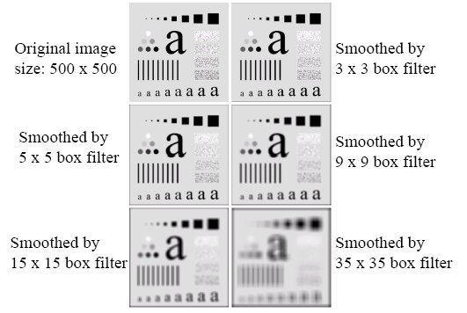
Spatial Filtering for Smoothing (Example)

Slide 33
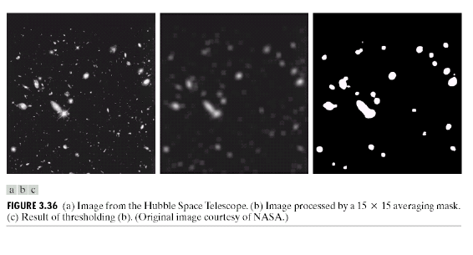
Spatial Filtering for Smoothing (Example)

Slide 34
Weighted Smoothing Filters
More effective smoothing filters can be generated by allowing different pixels in the neighbourhood different weights in the averaging function
  Pixels closer to the
  central pixel are more
  important
  Often referred to as a
  weighted averaging
¹/₁₆ | ²/₁₆ | ¹/₁₆
²/₁₆ | ⁴/₁₆ | ²/₁₆
¹/₁₆ | ²/₁₆ | ¹/₁₆
Weighted Averaging Filter

Slide 35
Order-Statistics Filtering
Nonlinear spatial filters
Output is based on order of gray levels in the masked area (sub-image)
Examples: Median filtering, Max & Min filtering
Median filtering
Assigns the mid value of all the gray levels in the mask to the center of mask;
Particularly effective when
  – the noise pattern consists of strong, spiky components (impulse
  noise, salt-and-pepper)
  – edges are to be preserved
  – Force points with distinct gray levels to be more like their neighbors

Slide 36
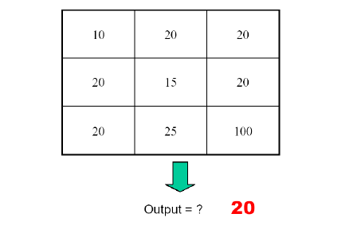
Median Filtering

Slide 37
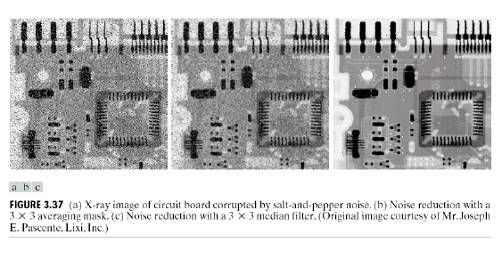
Median Filtering (Example)

Slide 38
Strange Things Happen At The Edges!
At the edges of an image we are missing pixels to form a neighbourhood
Origin
x
e
e
e
e
e
e
e
y
Image f (x, y)

Slide 39
Strange Things Happen At The Edges!
There are a few approaches to dealing with missing edge pixels:
  Omit missing pixels
    Only works with some filters
    Can add extra code and slow down processing
  Pad the image
    Typically with either all white or all black pixels
  Replicate border pixels
  Truncate the image
  Allow pixels wrap around the image
    Can cause some strange image artefacts

Slide 40
Simple Neighbourhood Operations Example
x
123
127
128
119
115
130
140
145
148
153
167
172
133
154
183
192
194
191
194
199
207
210
198
195
164
170
175
162
173
151
y

Slide 41
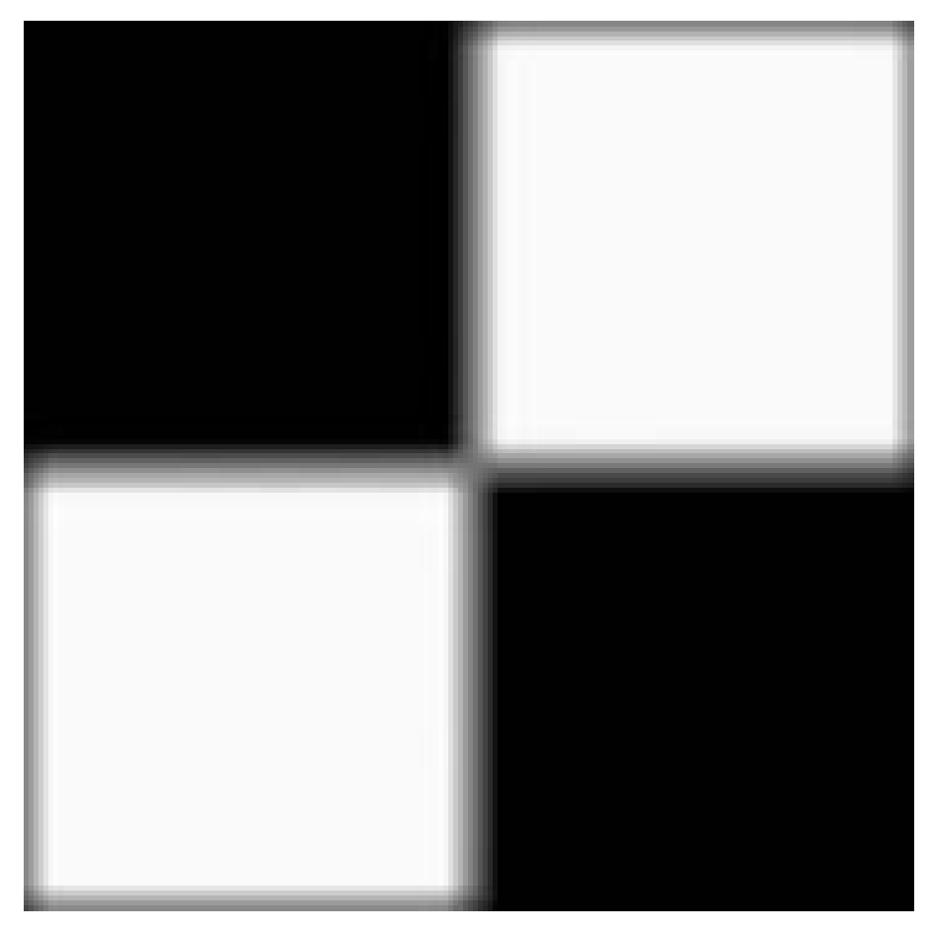

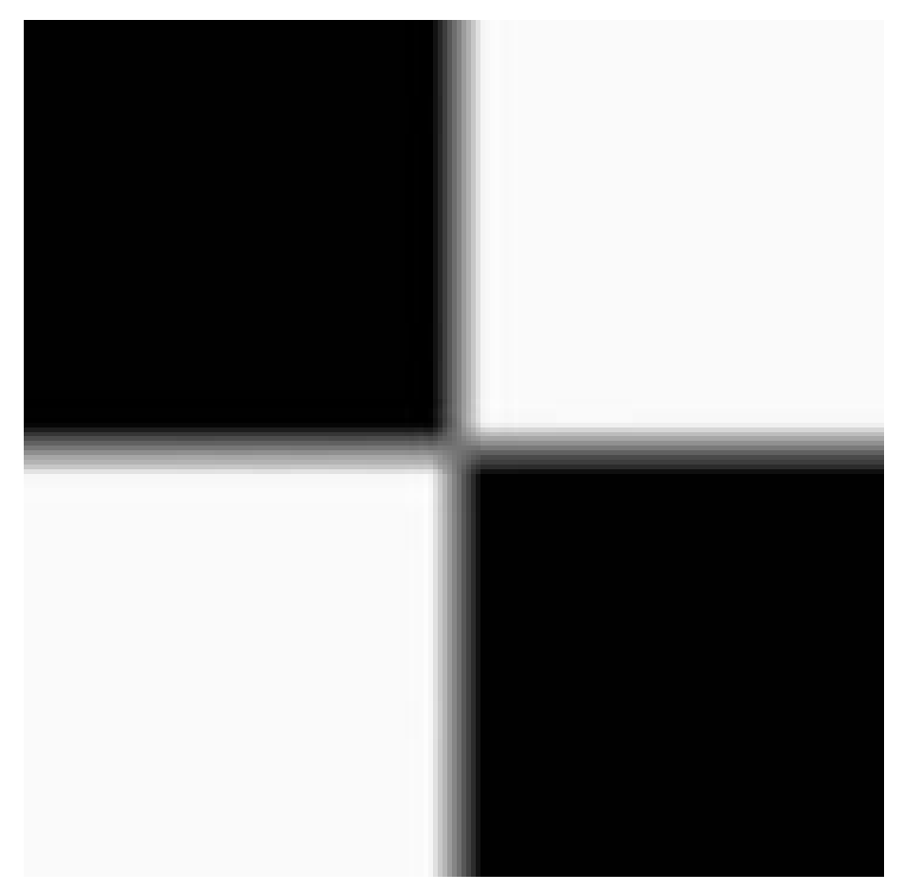


Strange Things Happen At The Edges! (cont…)
Filtered Image: Zero Padding
Original
Image
Filtered Image: Replicate Edge Pixels
Images taken from Gonzalez & Woods, Digital Image Processing (2002)
Filtered Image:
Wrap Around Edge Pixels

Slide 42
Correlation & Convolution
The filtering we have been talking about so far is referred to as correlation with the filter itself referred to as the correlation kernel
Convolution is a similar operation, with just one subtle difference
For symmetric filters it makes no difference
a
b
c
r
s
t
e_{processed} = v*e +
z*a + y*b + x*c +
w*d + u*e +
t*f + s*g + r*h
d
e
e
*
u
v
w
f
g
h
x
y
z
Original Image Pixels
Filter

Slide 43
Summary
In this lecture we have looked at the idea of spatial filtering and in particular:
  Neighbourhood operations
  The filtering process
  Smoothing filters
  Dealing with problems at image edges when using filtering
  Correlation and convolution
Next time we will looking at sharpening filters and more on filtering and image enhancement

Slide 44
Spatial Filtering for Image Sharpening
Background: to highlight fine detail in an image or to
enhance blurred detail
Applications: electronic printing, medical imaging, industrial
inspection, autonomous target detection (smart
weapons)......
Foundation:
Blurring/smoothing is performed by spatial averaging
(equivalent to integration)
Sharpening is performed by noting only the gray level
changes in the image that is the differentiation

Slide 45
Spatial Filtering for Image Sharpening
Operation of Image Differentiation
Enhance edges and discontinuities (magnitude of
output gray level >>0)
De-emphasize areas with slowly varying gray-level
values (output gray level: 0)
Mathematical Basis of Filtering for Image Sharpening
First-order and second-order derivatives
Approximation in discrete-space domain
Implementation by mask filtering

Slide 46
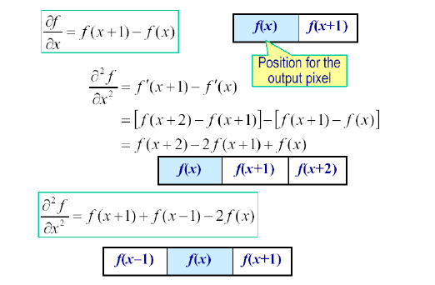
First and Second Order Derivatives

Slide 47
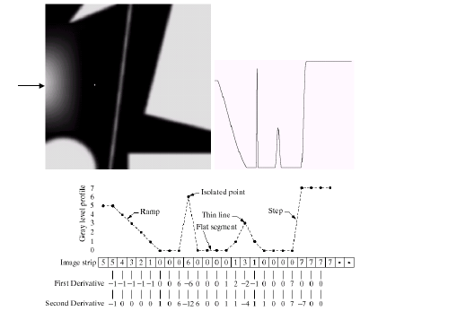
Example for Discrete Derivatives

Slide 48
Comparison between f" and f´
f´ generally produces thicker edges in an image
f" has a stronger response to fine detail
f´ generally has a stronger response to a gray-level step
f" produces a double response at step changes in gray level
For image enhancement, f" is generally better suited
than f´
Major application of f´ is for edge extraction; f´ used
together with f" results in impressive enhancement effect

Slide 49
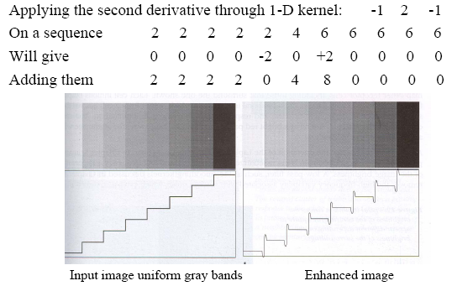
Enhancement by 2nd Derivative (Example)

Slide 50
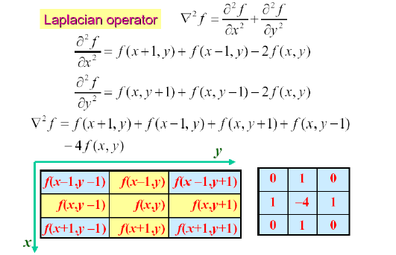
Laplacian for Image Enhancement

Slide 51
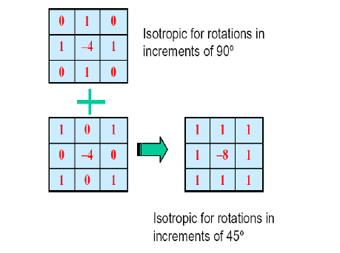
Laplacian for Image Enhancement

Slide 52
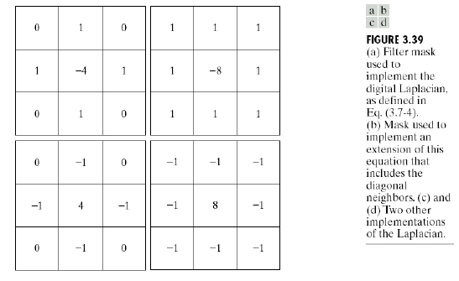
Laplacian for Image Enhancement

Slide 53
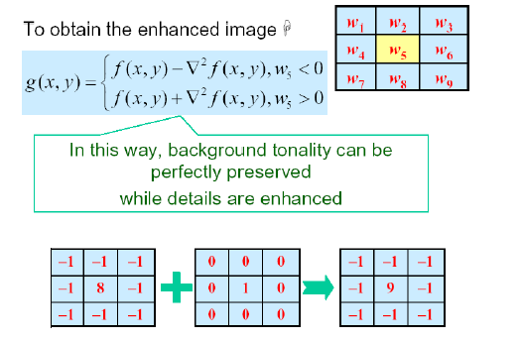
Laplacian for Image Enhancement

Slide 54
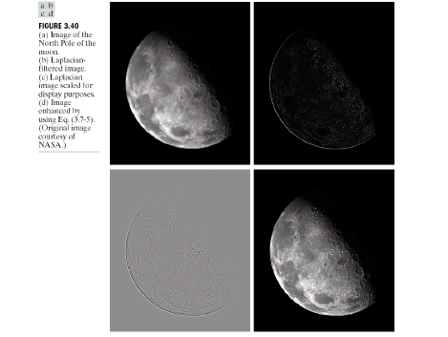
Laplacian for Image Enhancement (Example)

Slide 55
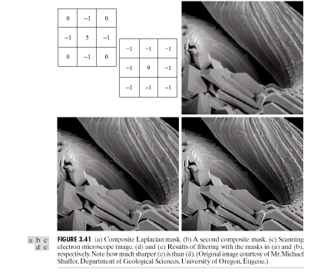
Laplacian for Image Enhancement (Example)

Slide 56
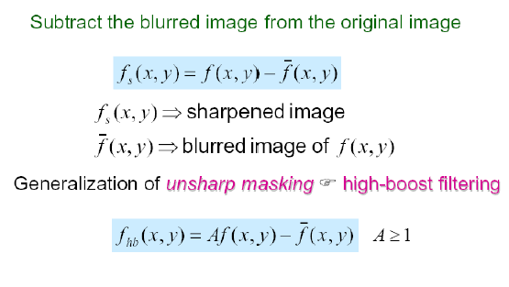
Image Sharpening Based on Unsharp Masking

Slide 57
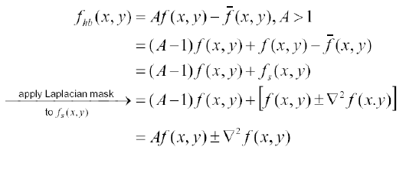
High Boost Filtering
Principal application:
Boost filtering is used when input image is darker than desired,
high-boost filter makes the image lighter and more natural

Slide 58
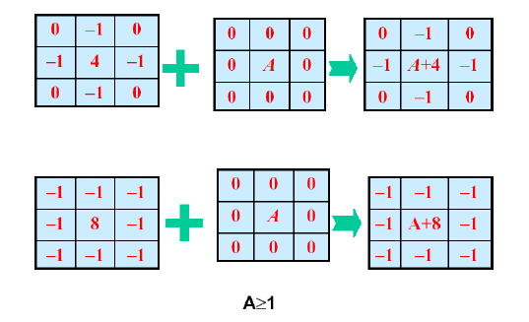
High Boost Filtering Masks

Slide 59
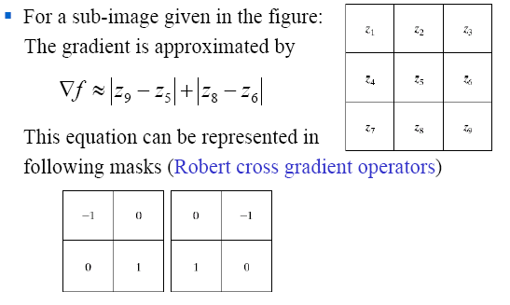
Gradient Operators

Slide 60
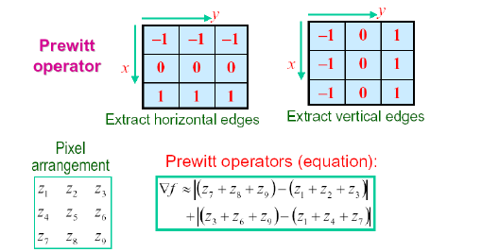
Gradient Operators
Normally the smallest mask used is of size 3 x 3
Based on the concept of approximating the gradient several
spatial masks have been proposed:

Slide 61
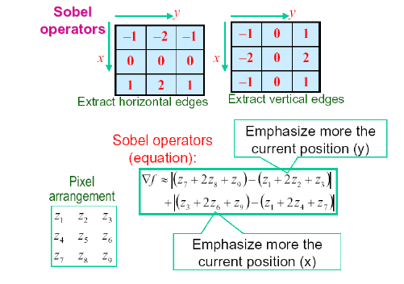
Gradient Operators

Slide 62
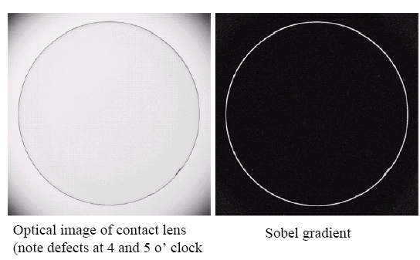
Gradient Processing (Example)

